Slide 1
OPERATING SYSTEMS
Process Synchronization
FBA

Slide 2
BACKGROUND
Processes can execute concurrently or in parallel
CPU scheduler switches rapidly between processes to provide concurrent execution
A process may be interrupted at any point in its instruction stream
Parallel execution, in which two instruction streams execute simultaneously on separate processing cores
We will explain how concurrent or parallel execution can contribute to issues involving the integrity of data shared by several processes

Slide 3
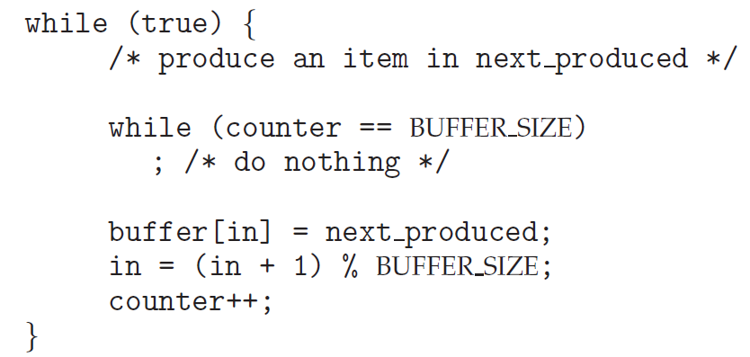
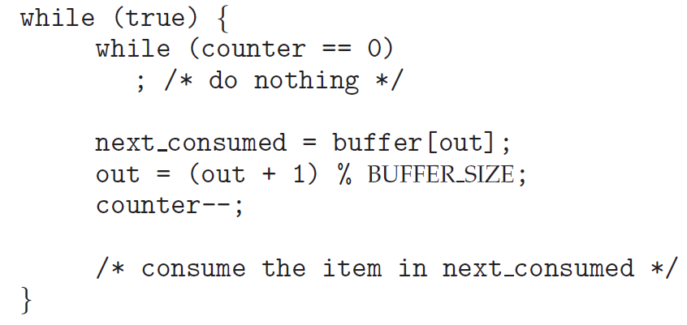
PRODUCER–CONSUMER PROBLEM
Modify the algorithm to remedy this deficiency - add an integer variable counter, initialized to 0
counter is incremented every time we add a new item to the buffer
decremented every time we remove one item from the buffer

Slide 4
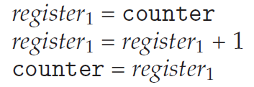
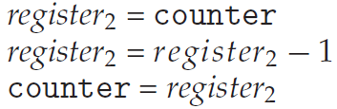
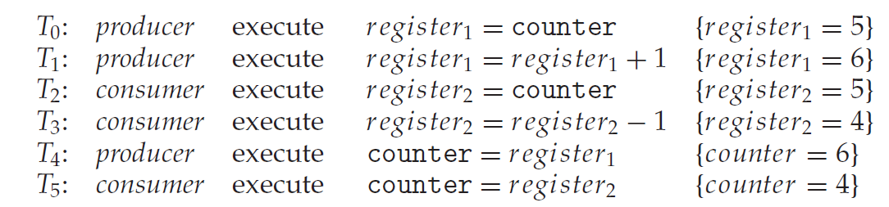
DATA INTEGRITY PROBLEM
“counter++” and “counter-- “ in machine language is like in the above.
register1 and register2 is local CPU registers.
Concurrent execution of “counter++” and “counter--” and allowing them to manipulate the counter variable create incorrect state.

Slide 5
RACE CONDITION
Several process access and manipulate the same data concurrently
Outcome of the execution depends on the particular order in which the access takes place
To guard against this condition –
Ensure that only one process at a time can manipulate the counter variable (shared data)
The processes should be synchronized

Slide 6
OPERATING SYSTEMS
Critical Section
FBA

Slide 7
CRITICAL SECTION
Consider a system consisting of n processes {P₀, P₁, ... , P_{n−1}}.
Critical Section: segment of code of each process, which may change common variables, update a table, write a file and so on.
While one process execute its critical section, no other process can execute their own critical section.
Entry Section: section of code implementing critical section execution request
Exit Section: section of code exiting from critical section
Remainder section: Remaining code of the program.

Slide 8
REQUIREMENTS OF SOLUTION TO CRITICAL SECTION PROBLEM
Mutual exclusion:
If a process is executing its critical section, no other process can be executing in their critical sections.
Progress:
No process is executing in its critical section
Some process wish to enter their critical sections
Only those, who are not executing in their remainder section can participate in deciding which will enter the CS.
This selection cannot be postponed indefinitely.
Bounded waiting:
Bound or Limit on number of times other process can enter their CS after a process has made request to enter its CS and the request is granted

Slide 9
CRITICAL SECTIONS IN OPERATING SYSTEMS
Two general approach to handle CS in Operating System –
Preemptive kernel: allows a process to be preempted while it is running in kernel mode
Non-preemptive kernel: a kernel-mode process will run until it exits kernel mode, blocks, or voluntarily yields control of the CPU
Non-preemptive kernel is free from race condition
Preemptive kernel must be carefully designed to ensure that shared kernel data are free from race condition

Slide 10
OPERATING SYSTEMS
Peterson’s solution for
Critical Section Problem
FBA

Slide 11
SOFTWARE-BASED SOLUTION TO THE CRITICAL SECTION PROBLEM
Known as “Perterson’s Solution”
Restricted to two processes that alternate execution between their critical sections and remainder sections
Peterson’s solution requires the two processes to share two data items:
int turn;
boolean flag[2];
turn: indicates whose turn it is to enter its critical section
flag: an array used to indicate if a process is ready to enter its critical section.

Slide 12
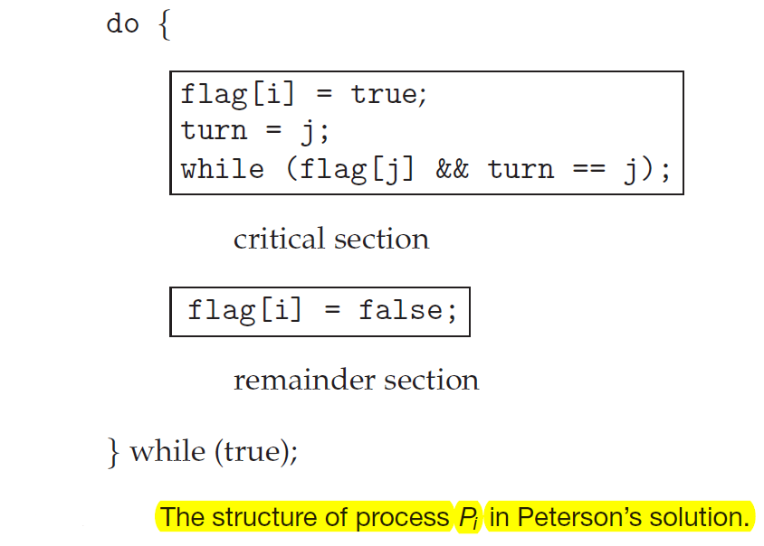
PETERSON’S SOLUTION
Process Pi first sets flag[i] to be true and then sets turn to the value j, so that if the other process wants to enter its CS, it can do so.
If both try to enter at the same time, turn will be both i and j at the same time, but, only one of these will last.
The eventual value of turn determines which process will enter its critical section.
It may not work correctly on modern computer architecture as they perform basic machine-language instructions such as load and store.

Slide 13
Example
Each Statement takes 2ms to execute, Process 1 gets executed first
Context Switch will occur after 6ms
Critical section contains 4 statements
Remainder section contains 2 statements
turn=0
Flag[0] = FALSE, flag[1] = TRUE
Process 0 (i = 0, j = 1) | Process 1 (i = 1, j = 0)
 | flag[1] = TRUE turn = 0 While loop condition
flag[0] = TRUE turn = 1 Stuck in while loop
 | CS1 CS2 CS3
Stuck in while loop
 | CS4 flag[1] = FALSE RS1
While loop condition CS1 CS2
 | RS2
CS3 CS4 flag[0] = FALSE
RS1 RS2

Slide 14
OPERATING SYSTEMS
Hardware based solution for
Critical Section Problem
FBA

Slide 15
HARDWARE-BASED SOLUTION TO THE CRITICAL SECTION PROBLEM
More solutions to the critical-section problem using techniques ranging from hardware to software-based APIs
These solutions are based on the premise of locking — protecting critical regions through the use of locks.
In a single-processor environment CS problem can be solved by preventing interrupts from occurring while a shared variable is being modified.
For multiprocessor environment, we need different measures.
Modern computer systems allow to test and modify the content of a word or to swap the contents of two words atomically – which is uninterruptable unit. We can use test_and_set() and compare_and_swap() instructions.

Slide 16
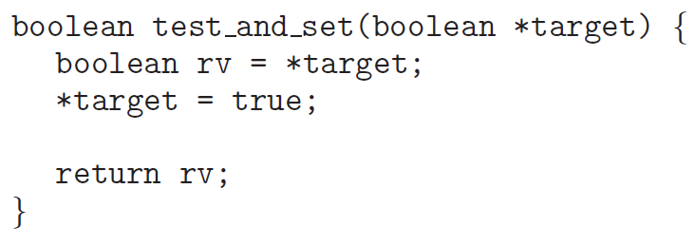
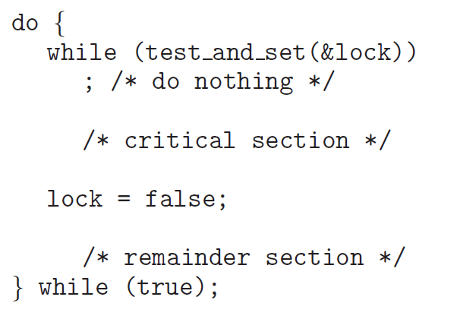
TEST_AND_SET( )
Executed atomically
Mutual exclusion can be implemented by initializing a Boolean variable lock to false

Slide 17
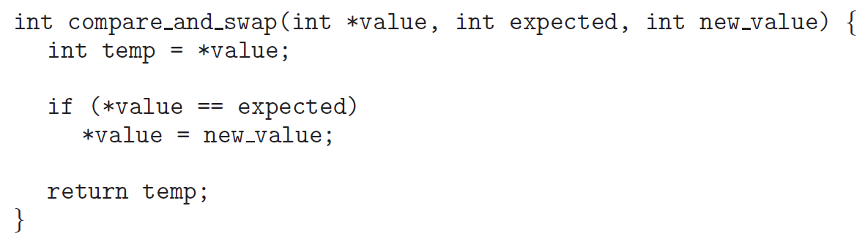
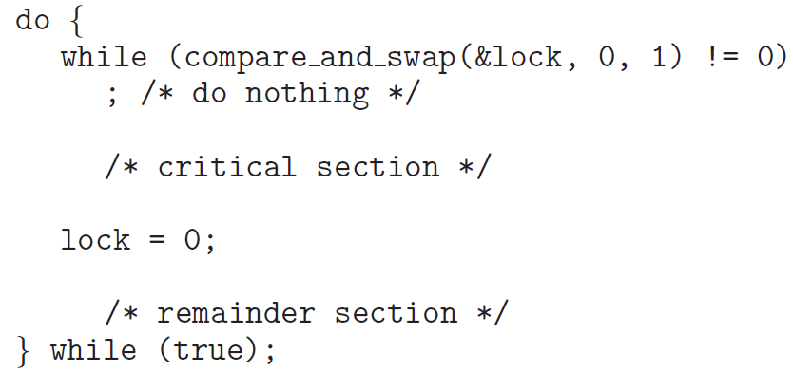
COMPARE_AND_SWAP( )
Mutual exclusion can be achieved by declaring a global variable lock and initializing it to 0
First process that invokes this instruction will set lock to 1 and no other process can execute CS until this process updates it to 0 after CS execution.

Slide 18
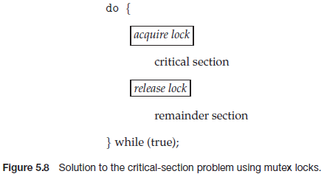
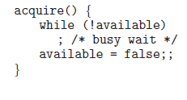

MUTEX LOCKS
Operating-systems designers build software tools to solve CS problem.
Simplest of these tools is “Mutex Lock” ( Mutex = Mutual Exclusion)
A process must acquire the lock before entering CS [ acquire() function ]
A process must release the lock after exiting the CS [ release() function ]
Mutex lock has a variable, available which indicates if the lock is available.

Slide 19
OPERATING SYSTEMS
Semaphore
FBA

Slide 20
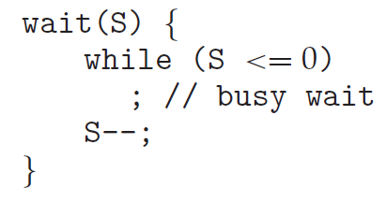
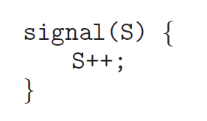
SEMAPHORE
A semaphore S is an integer variable
Is accessed only through two standard atomic operations: wait() and signal().
When one process modifies the semaphore value, no other process can simultaneously modify that same semaphore value.
In case of wait(S), the testing of the integer value of S (S ≤ 0), as well as its possible modification (S--), must be executed without interruption, i.e., this operations are atomic.

Slide 21
Types of Semaphores
Counting Semaphore: The value can range over an unrestricted domain.
Used to control access to a given resource consisting of finite number of instances
Solves various synchronization problems.
Binary Semaphore: The value can range only between 0 and 1. This behaves similar to Mutex Lock.

Slide 22
Counting Semaphore
initialized to the number of resources available, S = n
Each process that wishes to use a resource performs a wait() operation
S = S -1
When a process releases a resource, it performs a signal() operation
S = S +1
When S becomes 0, all resources are being used
processes that wish to use a resource will block until S>0

Slide 23
Binary Semaphore - Synchronization
P₁ has statement S₁
P₂ has statement S₂
We want to make sure that S₁ executes before S₂
We can use a semaphore variable sync and initialize it to 0
P1:
S1;
signal(sync);
P2:
wait(sync);
S2;

Slide 24
Mutual Exclusion With Semaphores
Binary Semaphores (mutex) can be used to solve CS problem.
A semaphore variable (say mutex) can be shared by n processes and initialized to 1.
Each process is structured as follows :
do{
wait (mutex);
//critical section
signal(mutex);
//remainder section
}while (TRUE);

Slide 25
Deadlock & Starvation
Two or more process can wait indefinitely for an event - DEADLOCK !!!
It occurs because - two process depends on each other for causing an event in a specific manner
Starvation: Processes wait indefinitely within the semaphore
Occurs if we remove processes from the list associated with a semaphore in LIFO (last-in, first-out) order
P₀
wait(S);
wait(Q);
. .
. .
. .
signal(S);
signal(Q);
P₁
wait(Q);
wait(S);
. .
. .
. .
signal(Q);
signal(S);

Slide 26
OPERATING SYSTEMS
Semaphore Implementation
FBA

Slide 27
SEMAPHORE IMPLEMENTATION
Must guarantee that no two processes can execute the wait() and signal() on the same semaphore at the same time
Thus, the implementation becomes the critical section problem where the wait and signal code are placed in the critical section
Could now have busy waiting in critical section implementation
But implementation code is short
Little busy waiting if critical section rarely occupied
Note that applications may spend lots of time in critical sections and therefore this is not a good solution

Slide 28
SEMAPHORE IMPLEMENTATION
When a process executes the wait() operation and finds that the semaphore value is not positive, it must wait
Rather than this busy waiting, the process can block itself which places it into a waiting queue associated with the semaphore
State of the process is switched to the waiting state and control is transferred to CPU scheduler which selects another process to execute.
It will be restarted when some other process executes a signal() operation
Restarted by a wakeup() operation that changes it from waiting state to ready state.

Slide 29
SEMAPHORE IMPLEMENTATION
Definition of a semaphore:
typedef struct {
int value;
struct process *list;
} semaphore;
Definition of wait():
wait(semaphore *S) {
S->value--;
if (S->value < 0) {
add this process to S->list;
block();
}
}
Definition of signal():
signal(semaphore *S) {
S->value++;
if (S->value >= 0) {
remove a process P from S->list;
wakeup(P);
}
}

